Slide 1

Twitter Music Recommendation Engine
GA Data Science course Fall 2013

Slide 2
Premise
Create a tool that can give you artist recommendations.
You enter your twitter handle, it spits back a list of artists whose twitter feeds are most similar to yours.

Slide 3
Overview or Process
Build library of artist twitter data.
Extract features.
Build recommender.
Interpret Results.
Tweak features and recommender based on results.

Slide 4
Building my Tweet library
Used the Echonest API to retrieve the top 1000 artists based on their “hotttnesss” metric.
Then queried the Twitter API to get the 200 most recent tweets for each artist.
Slightly over 518 artists had Twitter handles and enough data data to be included in the library.

Slide 5
Text processing
Used sci-kit’s provided stop words list. These stop words improved results.
Sci-kit automatically converts words to lower-case and does some regex processing for you.
This is an area that needs more focus as I try to further optimize the recommender.

Slide 6
Tf-idf token matrix
Converted text data to matrix of token counts
Weights a term based on its frequency in a single document and it’s inverse frequency in the whole corpus.
My matrix had 160,897 unique tokens.

Slide 7
Building the Recommender
Used NearestNeighbors from sci-kit learn.
Like KNN, but without the voting process.
Simply recommends the artists whose vectors are most similar to that of the input handle.

Slide 8
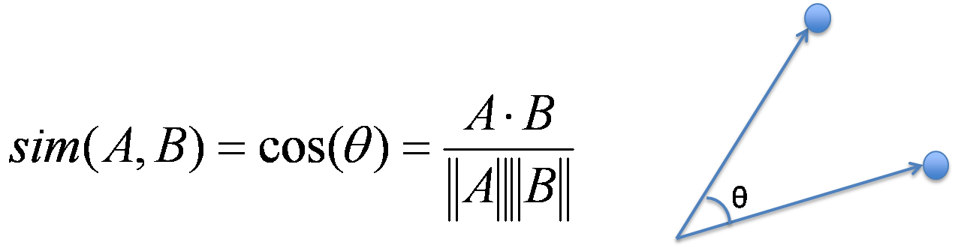
My distance metric
Intended to use cosine similarity.
Ended up using Euclidean distance, as it was faster and gave identical recommendations.

Slide 9
Interpret Results
This was hard due to unsupervised nature.
Decided that trying to recommend similar artists could be a good way to qualitatively determine if it was working.

Slide 10


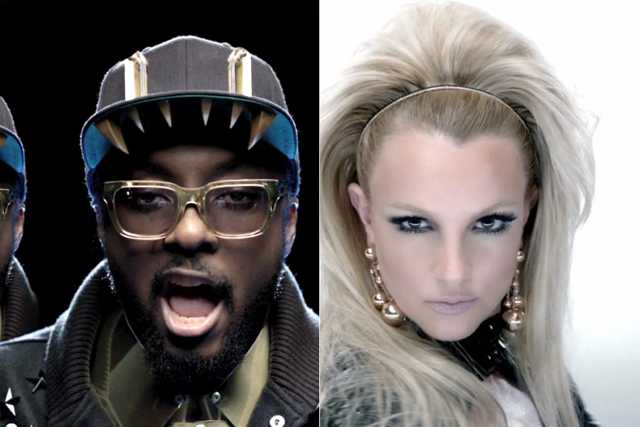
The Good
Could Identify Artists that collaborated together.

Slide 11

More Good
Effectively grouped foreign languages together.

Slide 12

The Bad
A few artists consistently showed up in recommendations.
Generic well-formed sentences
Location mentions
Selena Gomez is a pain in the ass.

Slide 13
Next Steps
Define a systematic approach for evaluating effectiveness of predictions.
Clustering?
More feature extraction.
NLTK
Lemmatisation, n-grams, PCA
Really explore the vector space
Prioritize mentions and hashtags?

Slide 14
What I learned
Text data is hard!
High dimensional vector spaces are hard!
JSON and API’s are nifty!
Maybe this approach is better at identifying direct links between artists, rather than general recommendations.

Slide 15
Thanks Jamar for the help!

